Slide 1
CA LAB(13) ESP8266 Wifi Module

Slide 2
Problem
We want to connect our MCU (Arduino) with Internet
Why we want Internet connection with Arduino?
To control and gather data from remote locations.
For communication purpose
To utilize existing infrastructure & protocols
For IoT

Slide 3
Connection with Internet
Arduino can connect with Internet through these ways
Ethernet
WiFi
3G,4G,GSM

Slide 4
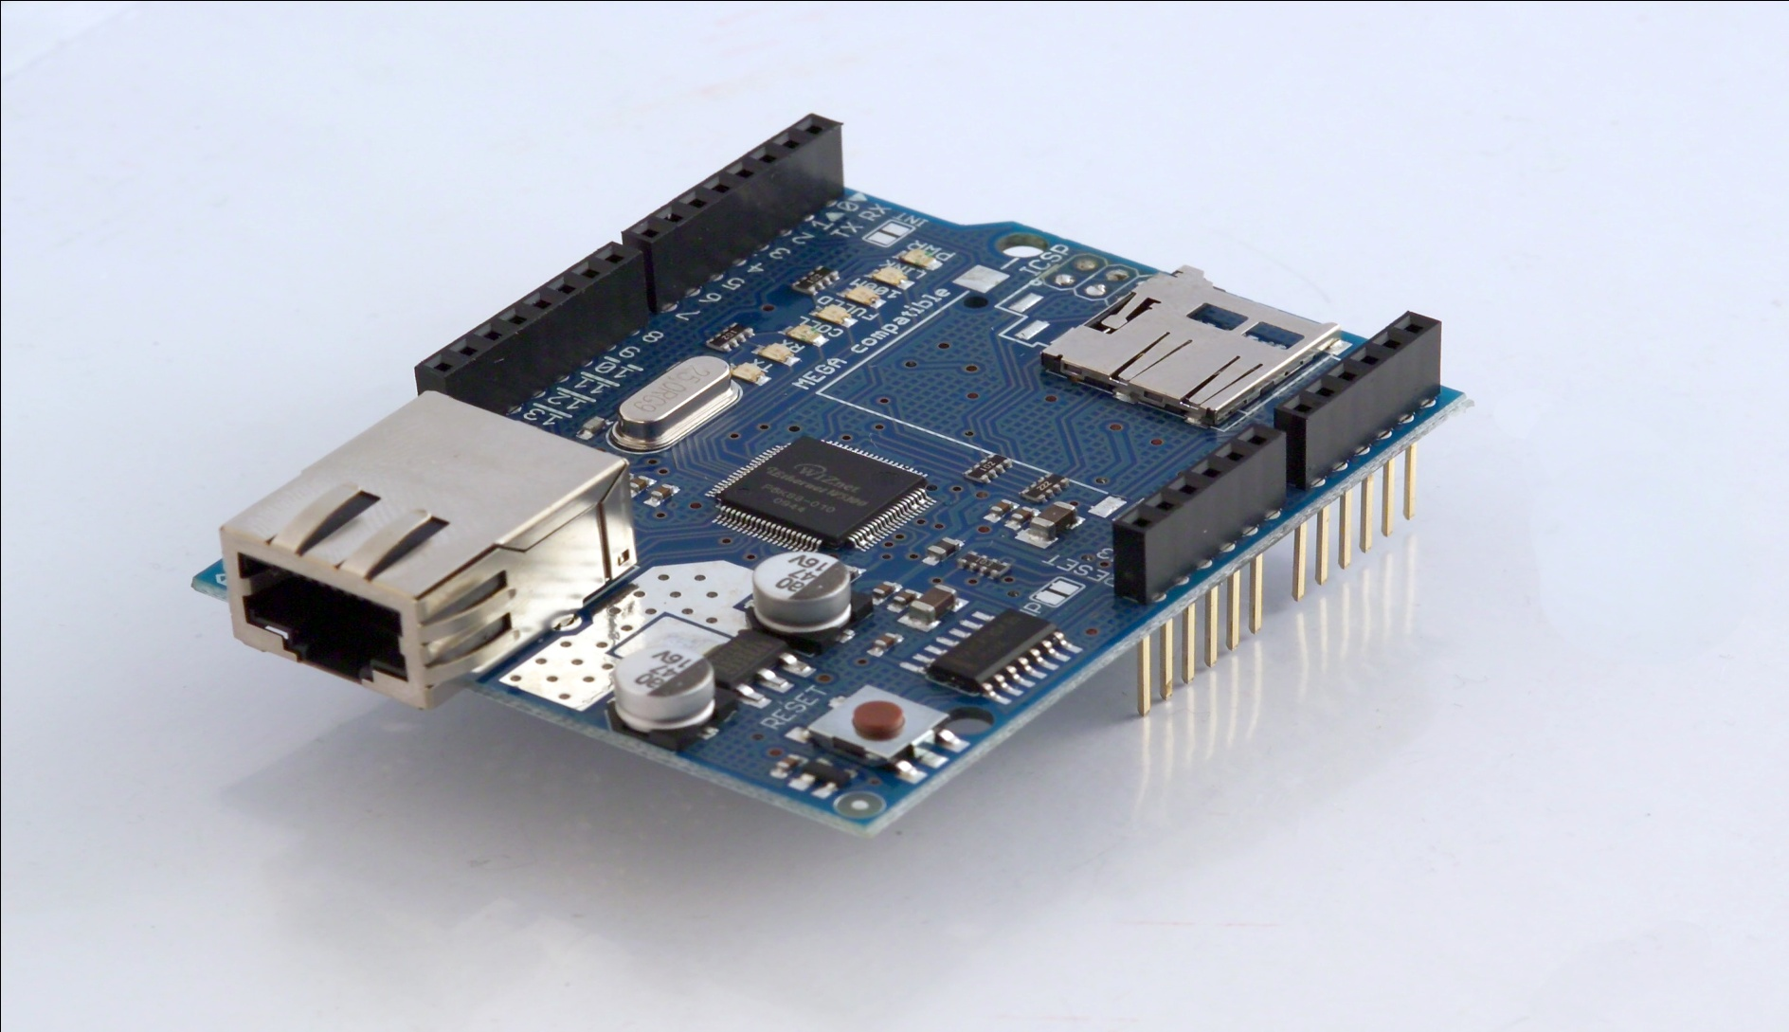
Ethernet

Slide 5
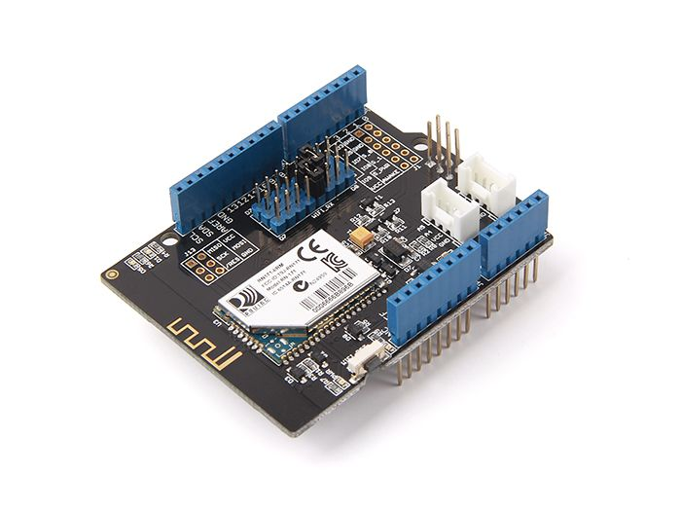
WiFi

Slide 6
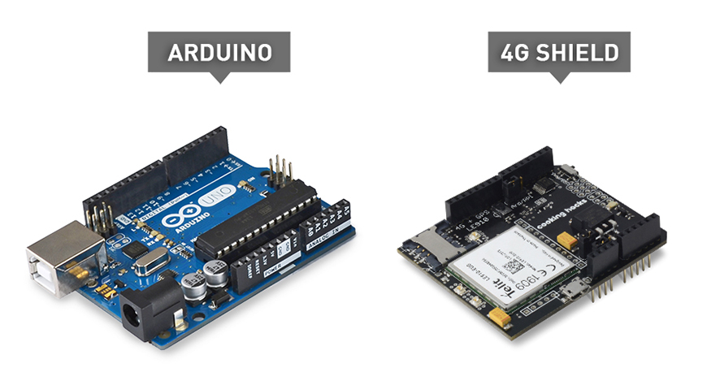
3G,4G

Slide 7
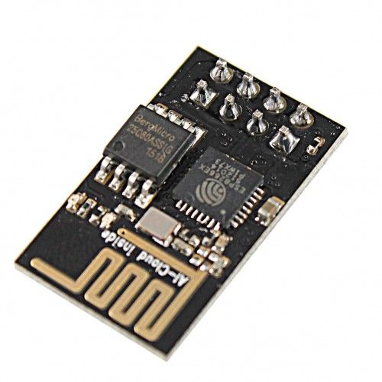
ESP8266

Slide 8
ESP8266
A popular and cheap module of WiFi for arduino
Simple serial interface
Operates on 3.3V more then 3.3V will damage the board. (Very sensitive)
AT commands
Has it’s own firmware and also can be programmed
Different operating modes

Slide 9
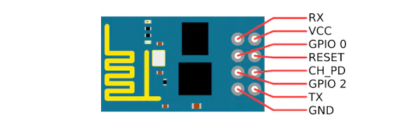
ESP8266 Pinout

Slide 10
ESP8266 Pinout
VCC for power connected with 3.3V
GPIO0 and GPIO2 are general purpose digital ports. GPIO0 also controls the module mode (programming or normal operation).
Rx is the receiver pin
Tx is the transmitter pin

Slide 11
ESP8266 Pinout
CH_PD: Chip enable. Keep it on high (3.3V) for normal operation.
RST: Reset. Keep it on high (3.3V) for normal operation. Put it on 0V to reset the chip.
GND is ground.

Slide 12
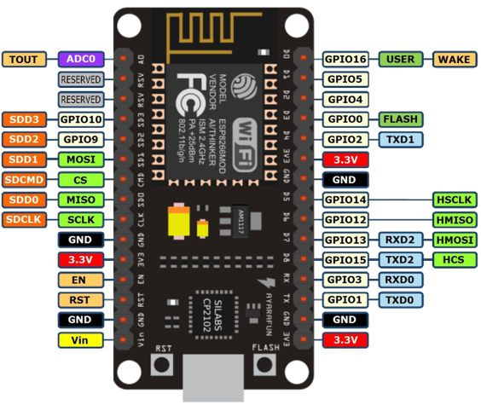
Node MCU

Slide 13
Node MCU
• Voltage:3.3V.
• Wi-Fi Direct (P2P), soft-AP.
• Current consumption: 10uA~170mA.
• Flash memory attachable: 16MB max (512K normal).
• Integrated TCP/IP protocol stack.
• Processor: Tensilica L106 32-bit.
• Processor speed: 80~160MHz.
• RAM: 32K + 80K.
• GPIOs: 17 (multiplexed with other functions).
• Analog to Digital: 1 input with 1024 step resolution.
• +19.5dBm output power in 802.11b mode
• 802.11 support: b/g/n.
• Maximum concurrent TCP connections: 5.

Slide 14
ESP8266 WiFi Modes
1. Access Point (AP) :In AP the Wi-Fi module acts as a Wi-Fi network, or access point (hence the name), allowing other devices to connect to it. It establishes a two-way communication between the ESP8266 and the device that is connected to it via Wi-Fi.

Slide 15
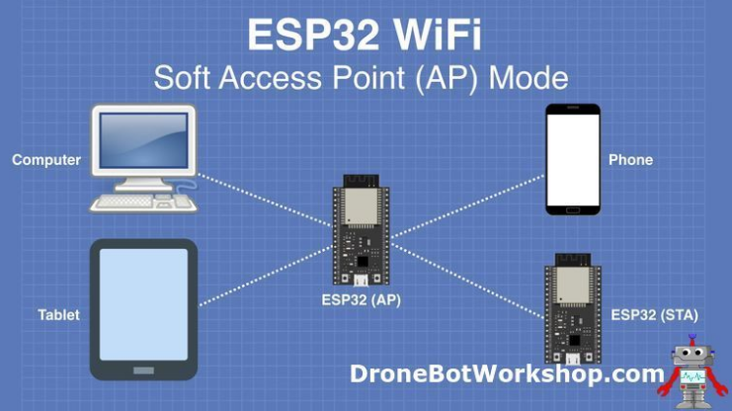

Slide 16
ESP8266 WiFi Modes
2. Station (STA) :In STA mode, the ESP-01 can connect to an AP (access point) such as the Wi-Fi network from your house. This allows any device connected to that network to communicate with the module.

Slide 17
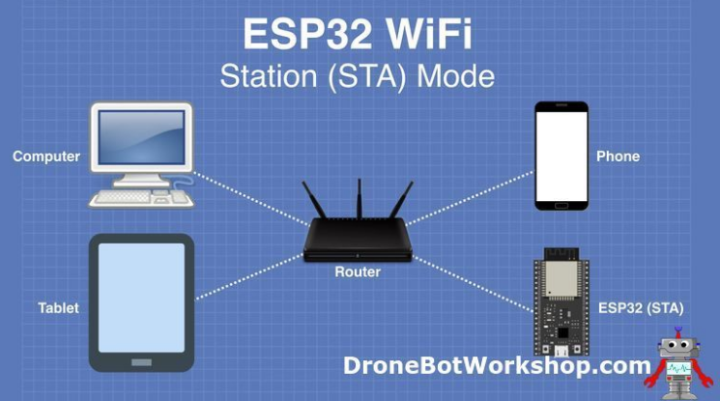

Slide 18
ESP8266 WiFi Modes
3. Both: In this mode ESP-01 act as both an AP as well as in STA mode.

Slide 19
Install the ESP8266 Board Package
In Arduino IDE goto file option and click on the preferences.
A new window will pop up in the settings Enter http://arduino.esp8266.com/stable/package_esp8266com_index.json into Additional Board Manager URLs.

Slide 20
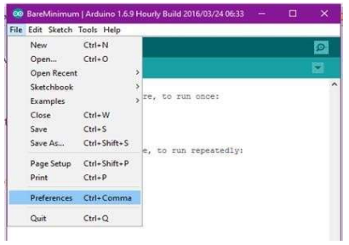

Slide 21
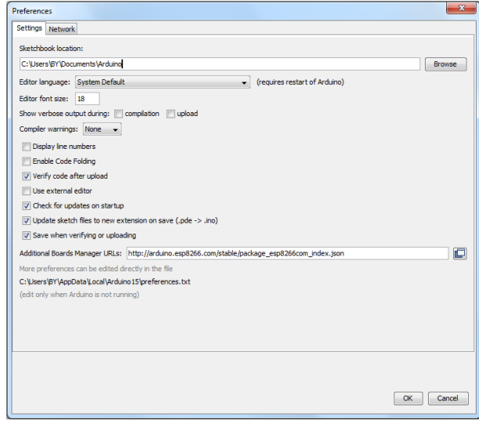

Slide 22
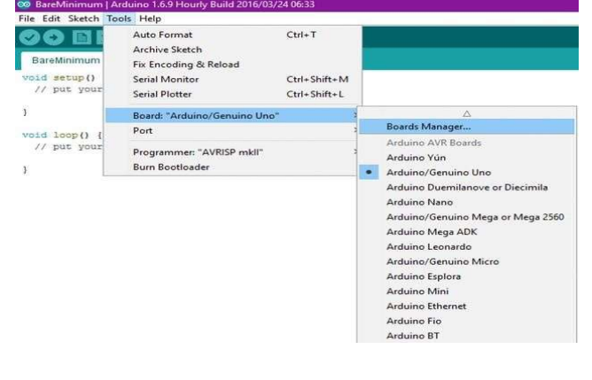
Click ‘Tools’ -> ‘Board:’ -> ‘Board Manager…’ to access this panel. In search type ESP8266

Slide 23
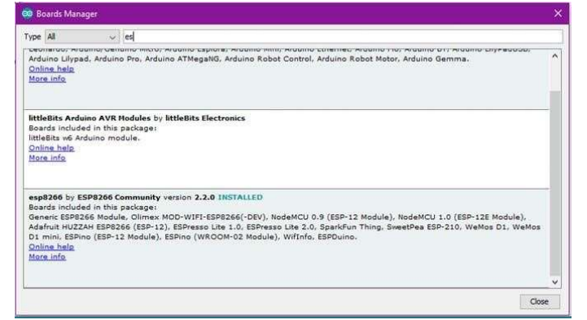

Slide 24
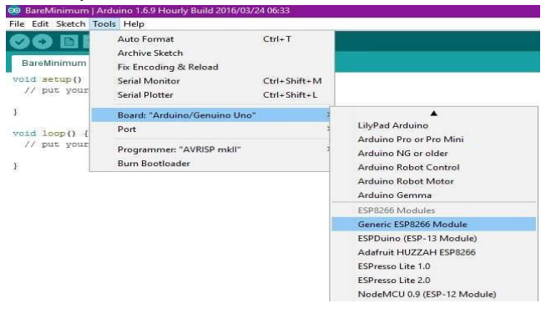

Slide 25
ESP8266
Now we will look how to establish connection of ESP8266 with Thingspeak using arduino

Slide 26
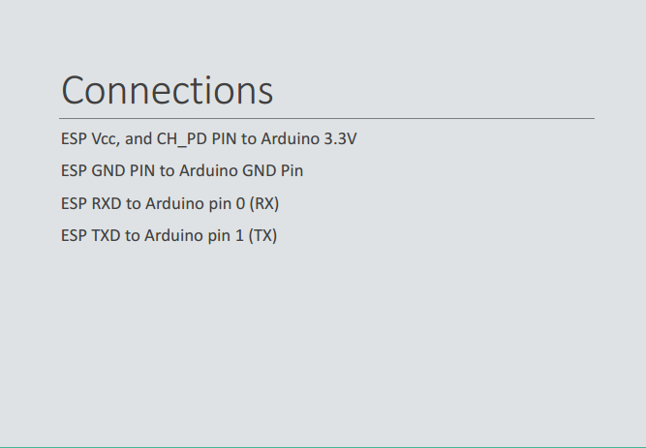

Slide 27
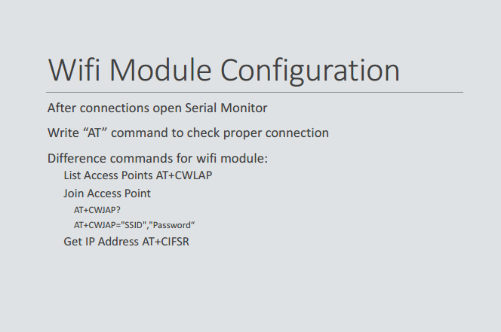

Slide 28
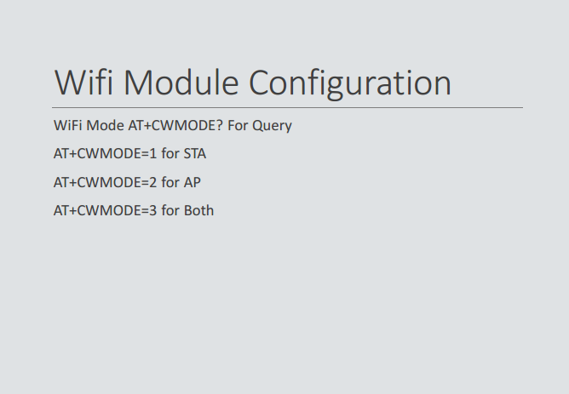

Slide 29
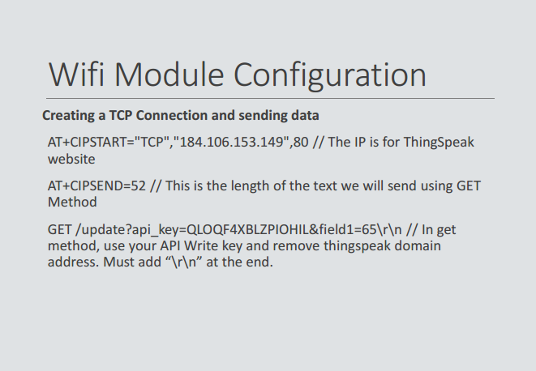

Slide 30
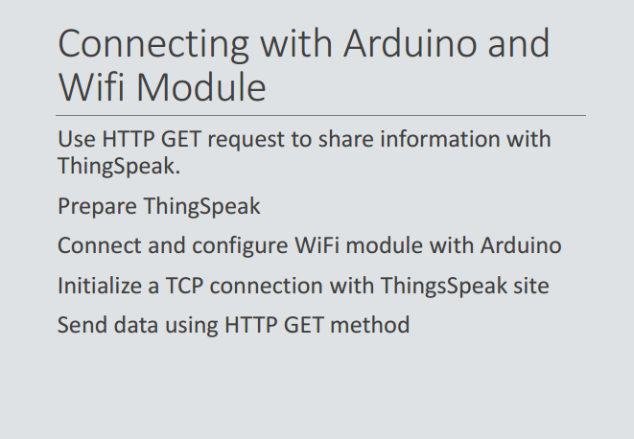

Slide 31
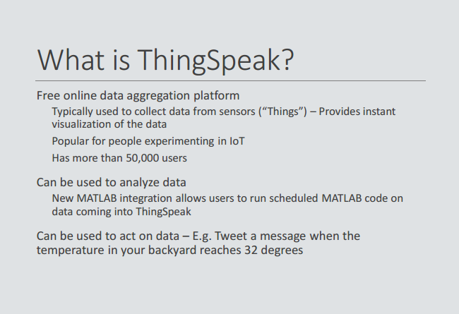

Slide 32
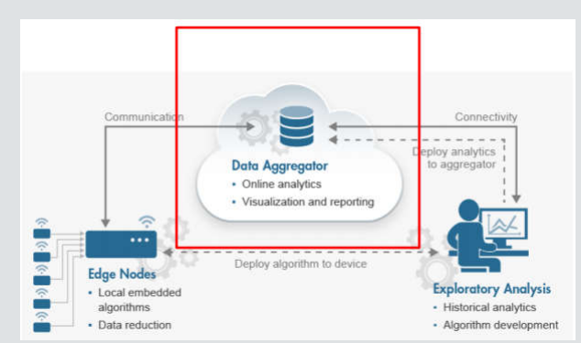

Slide 33
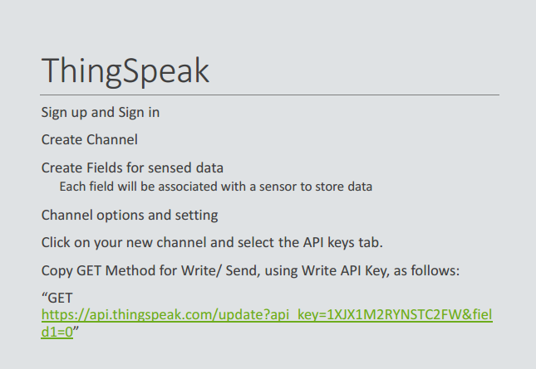

Slide 34
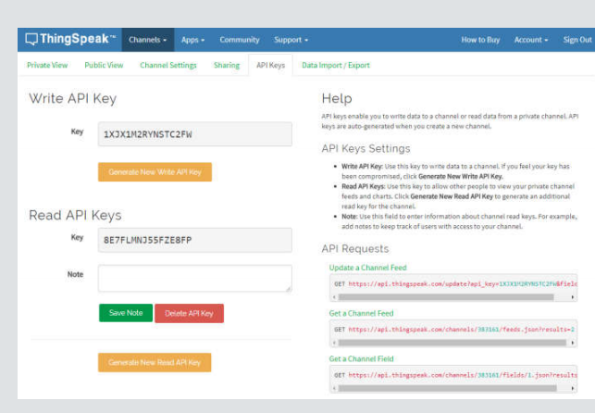

Slide 35


Slide 36
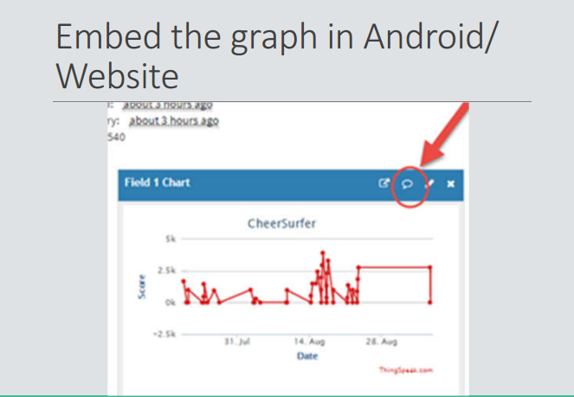

Slide 37
